Slide 1
0510-6201 – Digital Signal Processing Final Project
WNNVD – Weighted Nuclear Norm for Video Denoising
Roy Hachnochi , Uri kapustin

Slide 2
Table of Content
Mathematical background
Chosen paper & Our project
Literature review of related work
WNNVD
Results & Conclusion
Future work

Slide 3
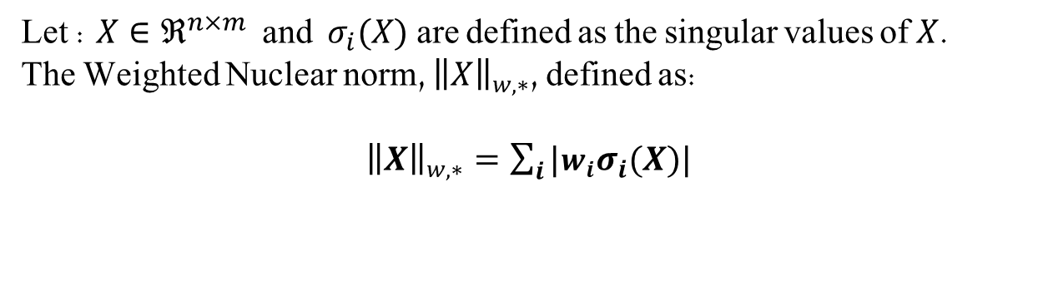
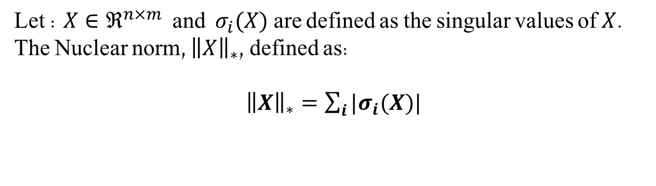
Nuclear Norm (NN)
Let : $X∈ℜ^{n×m}$ and $σ_{i}(X)$ are defined as the singular values of $X$.
The Nuclear norm, ${\left\|X\right\|}_{∗}$, defined as:
${\left\|X\right\|}_{∗}=\sum_{i}{|σ_{i}(X)|}$
Weighted Nuclear Norm (WNN)
Let : $X∈ℜ^{n×m}$ and $σ_{i}(X)$ are defined as the singular values of $X$.
The Weighted Nuclear norm, ${\left\|X\right\|}_{w,∗}$, defined as:
${\left\|X\right\|}_{w,∗}=\sum_{i}{|w_{i}σ_{i}(X)|}$

Slide 4
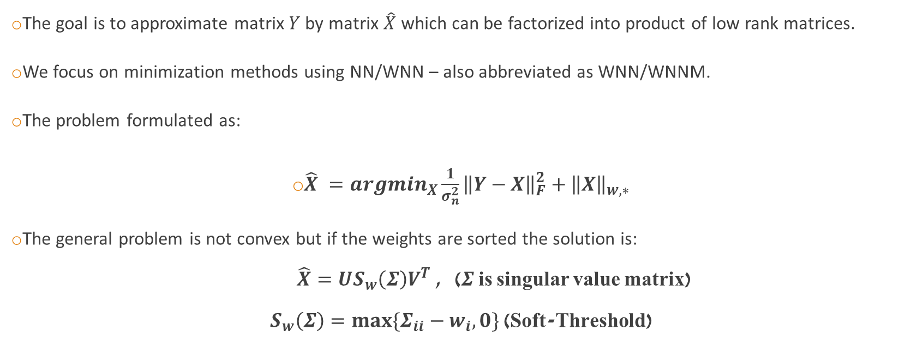
Low-Rank Matrix Approximation(LRMA)
The goal is to approximate matrix $Y$ by matrix $\hat{X}$ which can be factorized into product of low rank matrices.
We focus on minimization methods using NN/WNN – also abbreviated as WNN/WNNM.
The problem formulated as:
$\hat{X} =argmin_{X}\frac{1}{σ_{n}^{2}}{\left\|Y−X\right\|}_{F}^{2}+{\left\|X\right\|}_{w,∗}$
The general problem is not convex but if the weights are sorted the solution is:
$\hat{X}=US_{w}\left(Σ\right)V^{T}$ , ($Σ$ is singular value matrix)
$S_{w}\left(Σ\right)=max⁡\{Σ_{ii}−w_{i},0\}$ (Soft-Threshold)

Slide 5
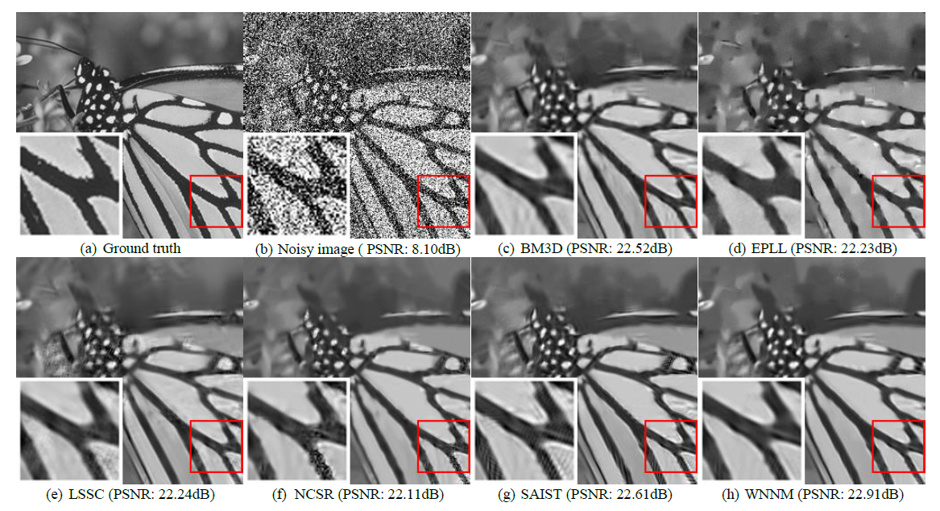
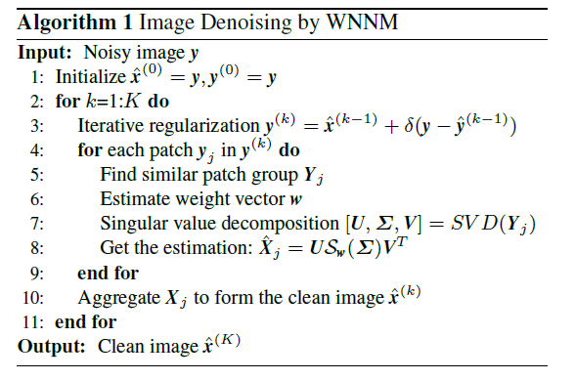
Chosen Paper
Weighted Nuclear Norm Minimization with Application to Image Denoising” [Gu et. al.]
Utilized the WNNM for image denoising by taking advantage of non-local self similarities
The Weighted Nuclear Norm Image
Denoising algorithm (WNNID)

Slide 6
Our Project
Weighted Nuclear Norm Minimization for Video Denoising (WNNVD).
Main Challenges:
Utilize temporal data (which is not used by the WNNID)
Integrate ideas and solutions from different papers.
Out of Scope:
Processing RGB images
Non-Causal algorithm

Slide 7
Literature Review – key papers
“A singular value thresholding algorithm for matrix completion” - this paper presented the NNM as a convex relaxation for the low-rank minimization problem
“Image Denoising by Sparse 3-D Transform-Domain” (BM3D) - was SOTA algorithm and used as comparison. Also, this paper use the same grouping method as WNNID – block matching(BM)
“Video Denoising by Sparse 3D Transform-Domain Collaborative Filtering” – proposed a grouping method which creates block from videos, utilizing temporal data. Our Block Matching block based on this method.
"Video Denoising, Deblocking, and Enhancement Through Separable 4-D Nonlocal Spatiotemporal Transforms“(VBM4D) – proposed a different grouping method. First creating temporal trajectories of patches and than search for similar trajectories. This is an addition to our project that we implemented.

Slide 8
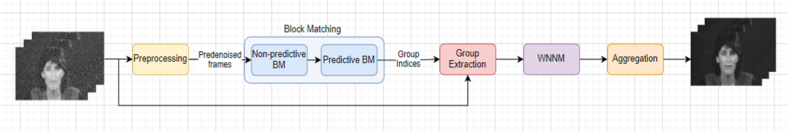
WNNVD – General Description
Algorithm block scheme:
The grouping step (“Block Matching”) has the most complicated logic
We also show using different block instead of “Block Matching” – “Trajectory Matching” as explained

Slide 9
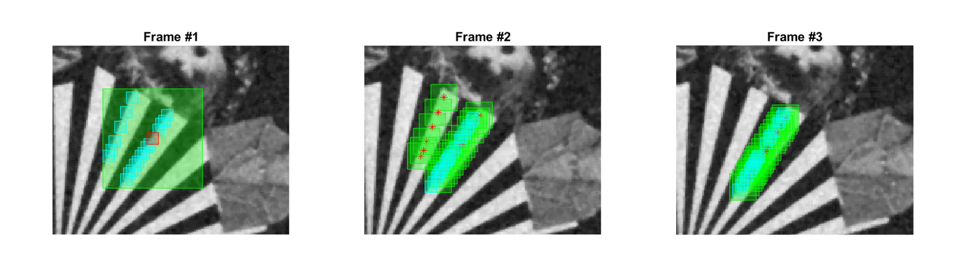
WNNVD – Block Matching
The grouping step. Each group(Block) will consist of similar patches both spatially and temporally
Grouping from different frames done sequentially
“Past” and “Future” frames handles separately
A list of reference patches chosen from a single frame
In our case we chose them by grid
Done in 2 phases search for similar patches:
Non-Predictive Search –
Executed only in the frame of each reference patch.
Performed on defined window size and stride.
Predictive Search –
Executed on the “past” and “future” frames.
Around each similar patch from the previous frame, we open a search window to find a defined number of similar patches

Slide 10
WNNVD – Group Extraction, Aggregation
Group Extraction –
The Block Matching collects list of indices.
This function take these indices and creates a new, vectorized, 2-D matrix.
This done for each reference patch and its matched group.
The vectorized matrix passed to the WNNM.
Aggregation –
The denoised patches (after the WNNM step) are placed back in the denoised video.
We hold a count, for each pixel, of its appearances in any group for 2 reasons:
In the block matching step, we don’t enforce unique group – so we need to know by how which factor to normalize each pixel’s value after placing back
Keep track of “denoised” pixels in order to make the later iterations more efficient in time

Slide 11
WNNVD – Preprocessing, WNNM
WNNM –
The denoising step. It based on the mathematical concepts that we presented.
Executed same as in our reference paper - On 2-D vectorized matrices.
Each matrix represent a matched block, where each column is a vectorized patch.
Preprocessing –
A simple and naïve video denoising, e.g Gaussian filter and Median filter.
The purpose of this step is to enhance the performance of the following block matching.

Slide 12

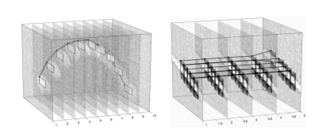
WNNVD – Extension
We tried to emphasize the temporal data because of its importance.
As explained in VBM4D, SOTA paper for video denoising
The main modification is the “Block Matching” block –
Instead of grouping patches, we group “trajectories”
Trajectory consist of sequence of patches from sequential frames, one from each frame.
Each trajectory created by harnessing the existing predictive and non-predictive search, more sophisticated ways considered but would exceed the scope of the project.

Slide 13
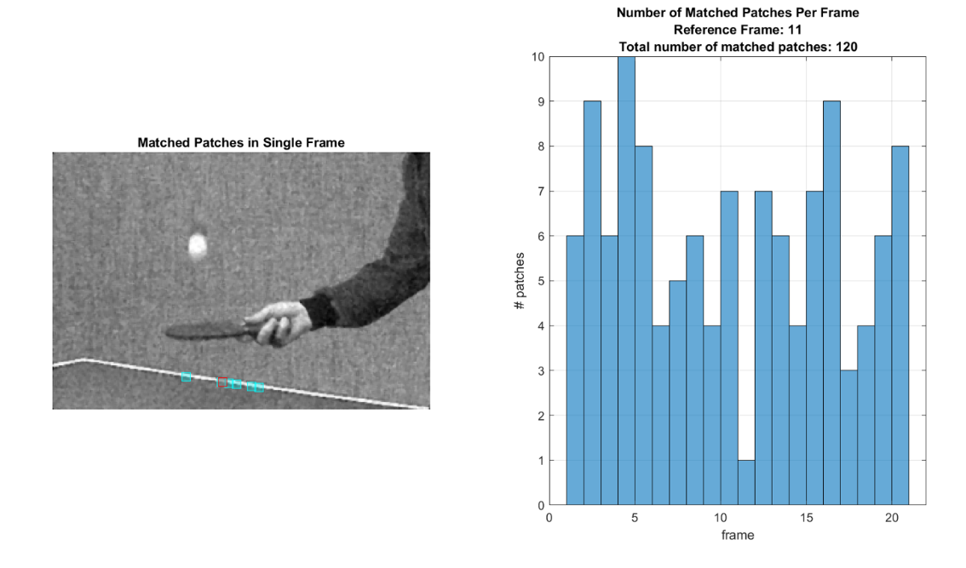
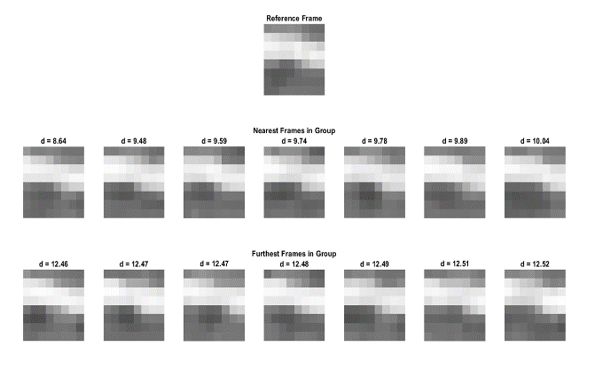
Results – Block Matching

Slide 14
Results – Parameter Analysis

Slide 15
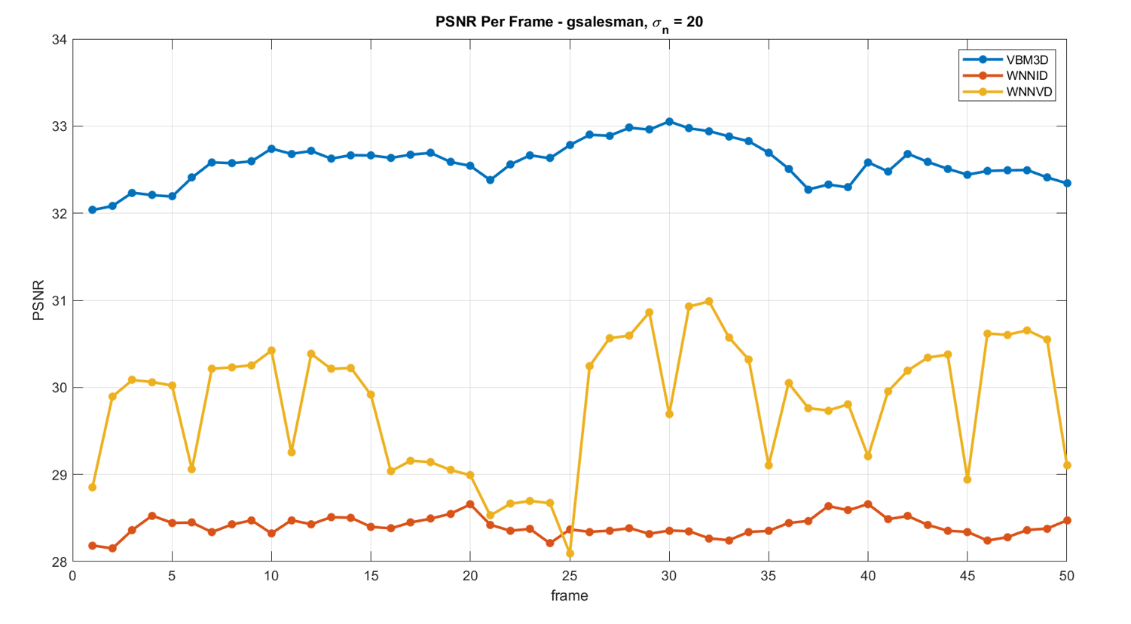
Results - Comparison

Slide 16
Results - Comparison
Noise STD | Video | Algorithm | PSNR | SSIM | Time per frame [sec]
10 | gbicycle | VBM3D | 36.5 | 0.97 | 1.12
 |  | WNNID | 34.2 | 0.97 | 73.35
 |  | WNNVD | 36.1 | 0.97 | 62.92
 | gflower | VBM3D | 29.8 | 0.95 | 0.19
 |  | WNNID | 27.7 | 0.93 | 11.23
 |  | WNNVD | 28.8 | 0.94 | 12.03
 | gmissa | VBM3D | 39.3 | 0.93 | 0.26
 |  | WNNID | 37.8 | 0.92 | 21.12
 |  | WNNVD | 38.2 | 0.92 | 16.23
 | gsalesman | VBM3D | 36.4 | 0.95 | 0.24
 |  | WNNID | 32.9 | 0.91 | 19.24
 |  | WNNVD | 34.2 | 0.92 | 10.18
 | gstennis | VBM3D | 31.8 | 0.87 | 0.21
 |  | WNNID | 29.6 | 0.83 | 16.55
 |  | WNNVD | 29.2 | 0.77 | 12.92
 | lena | WNNVD | 35.3 | 0.91 | 49.81
20 | gbicycle | VBM3D | 33.6 | 0.95 | 1.13
 |  | WNNID | 29 | 0.92 | 72.36
 |  | WNNVD | 32.6 | 0.95 | 63.79
 | gflower | VBM3D | 27.5 | 0.91 | 0.19
 |  | WNNID | 23.7 | 0.85 | 11.01
 |  | WNNVD | 26 | 0.85 | 14.79
 | gmissa | VBM3D | 37.5 | 0.91 | 0.26
 |  | WNNID | 34.1 | 0.88 | 20.52
 |  | WNNVD | 35.5 | 0.9 | 17.37
 | gsalesman | VBM3D | 33.6 | 0.91 | 0.25
 |  | WNNID | 28.8 | 0.81 | 19.12
 |  | WNNVD | 30.1 | 0.82 | 11.78
 | gstennis | VBM3D | 29.6 | 0.77 | 0.21
 |  | WNNID | 26.8 | 0.67 | 16.39
 |  | WNNVD | 26.3 | 0.53 | 15.27
 | lena | WNNVD | 32.2 | 0.87 | 49.64
30 | gbicycle | VBM3D | 31.1 | 0.93 | 1.13
 |  | WNNID | 26.5 | 0.9 | 71.66
 |  | WNNVD | 29.4 | 0.9 | 65.86
 | gflower | VBM3D | 25.4 | 0.86 | 0.19
 |  | WNNID | 21.2 | 0.78 | 11.07
 |  | WNNVD | 22.6 | 0.74 | 15.64
 | gmissa | VBM3D | 35.6 | 0.91 | 0.26
 |  | WNNID | 32.6 | 0.88 | 20.47
 |  | WNNVD | 33.3 | 0.88 | 18.24
 | gsalesman | VBM3D | 30.9 | 0.85 | 0.25
 |  | WNNID | 26.7 | 0.73 | 19.03
 |  | WNNVD | 27.3 | 0.72 | 13.27
 | gstennis | VBM3D | 27.7 | 0.66 | 0.21
 |  | WNNID | 25.3 | 0.57 | 16.22
 |  | WNNVD | 25.6 | 0.5 | 17.47
 | lena | WNNVD | 30.2 | 0.84 | 48.98

Slide 17
Suggested Future Work
Parameter optimization
Instead of vectorizing blocks, work with 3-D/4-D blocks and implementing High-Order SVD
Modify the algorithm for an online video denoising ( causal denoise)
Expand the algorithm to support RGB images/videos.
Optimize run-time.

Slide 18
Summary
The core signal-processing concept we studied is LRMA utilization for image and video denoising.
Specifically, NNM/WNNM relaxation methods.
We explored different ways of grouping methods (BM,TM).
We conducted analysis and research of our proposed algorithm.
We compared out result to SOTA papers in the classical regime of video and image denoising

